Slide 1
CS 4530: Fundamentals of Software Engineering
Module 14: Software Engineering & Security
Adeel Bhutta
Khoury College of Computer Sciences
© 2026, released under CC BY-SA

Slide 2
Learning Objectives for this Module
By the end of this module, you should be able to:
Define key terms relating to software/system security
Explain 5 common vulnerabilities in web applications and similar software systems, and describe some common mitigations for each of them.
Explain why software alone isn’t enough to assure security
Explain at least one way in which security can be incorporated into an agile development process

Slide 3
Outline of this lecture
Definition of key vocabulary
Some common vulnerabilities, and possible mitigations
Getting security right is about people as well as software.
Notes:
<Read slide>
Part 2 is the largest portion of the lecture.

Slide 4
Security: Basic Vocabulary (1)
Security is a set of non-functional requirements (sometimes called “CIA”):
Confidentiality: is information disclosed to unauthorized individuals?
Integrity: is code or data tampered with?
Availability: is the system accessible and usable?
Notes:
Security is often considered a broad non-functional requirement: systems are expected to be “secure”. But as we’ll see in this lecture, security covers a range of different security requirements. Here are three common security requirements.
Confidentiality - is information disclosed to unauthorized parties?
Integrity - is our code or data tampered with, at rest, or in transit
Availability - Can someone prevent my system from otherwise functioning? note that leaving something unplugged solves confidentiality and integrity :)
Discussion: Think about recent examples of security events and how they violated these properties

Slide 5
Security: Basic Vocabulary (2)
Asset: something of value that is the subject of a security requirement
Threat: potential condition or event that could compromise a security requirement
Vulnerability: a characteristic or flaw in system design or implementation, or in the security procedures, that, if exploited, could result in a security compromise

Slide 6
Security: Basic Vocabulary (3)
Attack Surface: a portion of the system that might contain a vulnerability
Exploit: a technique or method for exploiting a vulnerability
Attack: an event that results in the realization of a threat
Mitigation: a technique for making an attack less likely, more expensive, or less valuable to an attacker.

Slide 7
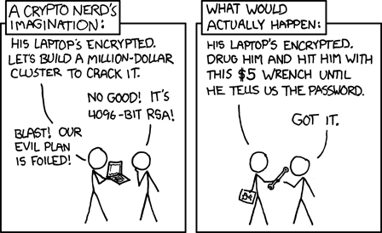
Security is a multiplayer game
The threat model specifies the rules you imagine that the other person is playing by
GameNite has radically different applicable threat models than, say, the State Department.
The attack surface specifies where the other player gets to play the game
https://xkcd.com/538/

Slide 8
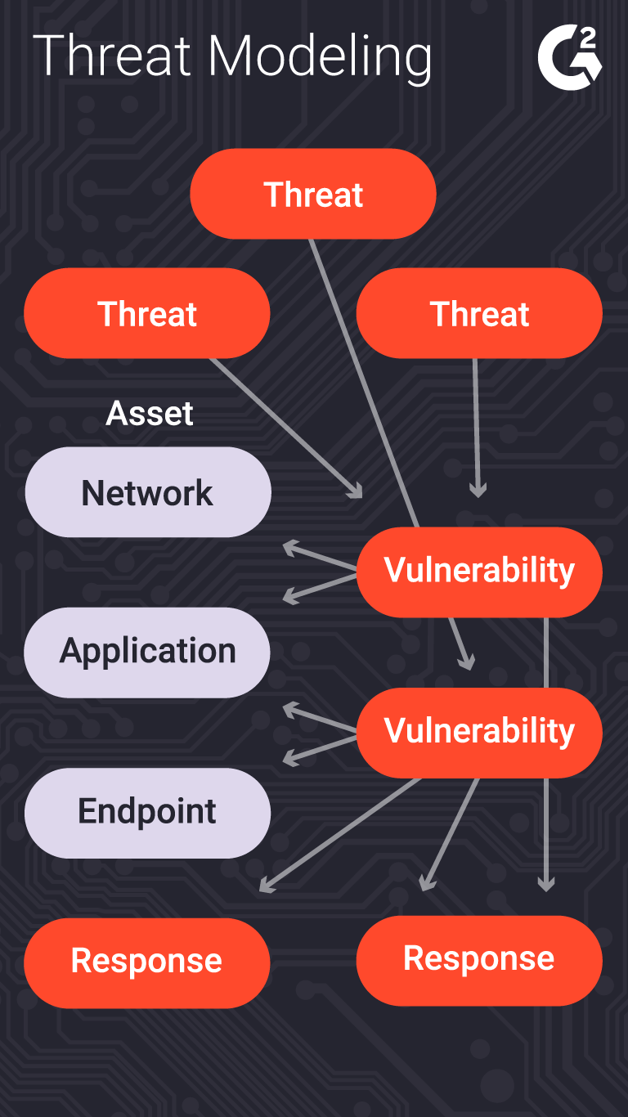
Threat modeling can help us analyze the issues
What is being defended?
What malicious actors exist and what attacks might they employ?
What value can an attacker extract from a vulnerability?
Who do we trust? What parts of the system do we trust?
What can we do in case of attack?
Notes:
The process of considering the potential risks, and ”non risks”, or trusted actors/components, is called “threat modeling”.
This is typically a structured process in which an organization analyzes questions like:
(read slide)
Of course, creating a threat model is not a one-time event. The model will need to be continually revised during the development process as the system is refined, and after deployment as the environment changes.
Of course there’s a whole ecosystem of consultants to help with this process.

Slide 9
Security is a multiplayer game
Simple threat model and attack surface: on the web, an attacker can make arbitrary requests to any API endpoint, send arbitrary messages over websockets, and can directly interpret every message that comes from the server.
Mitigations:
Don't put secrets in client code
Aggressively validate API requests
more on this later.

Slide 10

Security isn't always free
In software, as in the real world…
You just moved to a new house, someone just moved out of it. What do you do to protect your belongings/property?
What are the assets that need protection?
residents, furniture, cash, your stuff
What are the vulnerabilities?
doors, windows
Notes:
Before getting into software security, let’s talk a bit about physical security. Imagine that you have just moved to a new house, and someone just moved out. Are there things that you would want to do to secure your belongings? For instance - do you change the locks? Maybe you are concerned that the former tenant still has keys.
(Walk through example, then ultimately point out that you live in a house with lots of glass)

Slide 11
What are the threats? What are possible mitigations?
Threat/Exploit | Mitigation
Fire | Smoke alarm, fire extinguisher
Hurricane | Strengthen windows; raise house; move away
Burglary | Burglar alarm? Better locks? Strengthen windows?
Former owner has keys | Change locks
Terrorism | ???
Nuclear war | ????
???

Slide 12
STRIDE Framework can help identify Common Threats
The STRIDE framework is useful to reason about potential threats.
Spoofing
Tampering
Repudiation
Information Disclosure
Denial of Service
Elevation of Privilege
Notes:
<read slide>

Slide 13
Five major classes of vulnerabilities
Vulnerability 1: Code that runs in an untrusted environment
Vulnerability 2: Untrusted Inputs
Vulnerability 3: Bad authentication (of both sender and receiver!)
Vulnerability 4: Malicious software from the software supply chain
Vulnerability 5: Failure to apply security policy.
https://owasp.org/Top10/2025/
Notes:
Here are 5 general classes of vulnerabilities. For each vulnerability, we will look at possible exploits and possible mitigations.
An unfortunate recurring theme that we will see in these defenses is that there is no silver bullet. An extremely motivated attacker (say, a nation-state like the US, China, or Russia) can likely, with enough time and resources, break into anything. But, we will see what we can do to increase the cost of that attack.

Slide 14

Vulnerability 1 Example: authentication code in a web application
function checkPassword(inputPassword: string){
if(inputPassword === 'letmein'){
return true;
}
return false;
}
Front End
Curses! Foiled Again!
User controls this
Trust boundary
Back End
Fix: Move code to back end (duh!)
We control this
Notes:
What if we put some sensitive code in the front end of our web app? In general, there’s nothing to prevent the user from looking at the code or modifying it. Here, the correct password is sitting in plaintext where the user can find it.
That’s an extreme example, of course, but there are others: the user might be able to extract keys and other secrets from the front-end code.
The general fix to this is to move that sensitive code into our backend, which we should, hopefully, trust to faithfully execute the code.
Another example: if we have external services (like a database, or some other API, like one for accessing cloud resources), we might be tempted to distribute our database password (or key for third party API) with the application, so that it can directly connect to our database.
Our frontend might try to restrict what data the user can access, but because the user can also use these credentials to directly connect to our database, they will have the power to do whatever is permitted for those credentials.
(Professor Wand says: yes, this animation is cheesy, but I had way too much fun doing it).

Slide 15
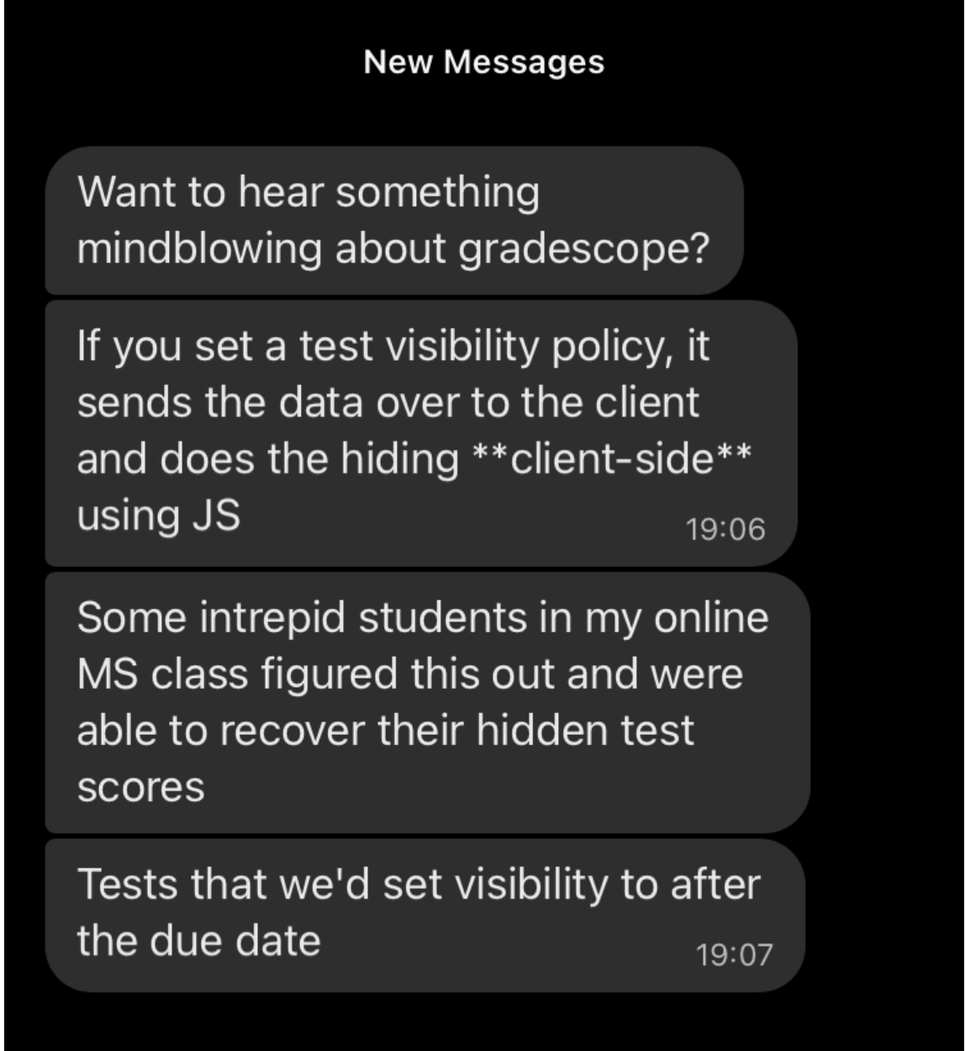
Who would do such a silly thing?
Notes:
<click>
Answer: Gradescope!

Slide 16
Security Principle #1: Minimize Attack Surfaces
Mitigations:
Study new APIs and commands for new attack surfaces
Remove extraneous dependencies
Remove unneeded APIs and commands
Authenticate users of APIs

Slide 17
Vulnerability 2: Data controlled by a user flowing into our trusted codebase
https://xkcd.com/327/
Notes:
The next class of threat that we will consider is: untrusted user inputs. Imagine that we have solved our problem of “do we trust where the code runs” by running that code on our own server that we control. Surely, we still receive inputs from users, who we should not trust.
Here is a pop-culture reference from XKCD that makes fun of this class of threat

Slide 18
Example: code injection
String query = "SELECT * FROM accounts WHERE name='" + request.getParameter(“name") + "'";
Parameter name | Constructed Query | Effect
Alice | SELECT * FROM accounts WHERE name=‘Alice’; | Select a single account
Alice O’Neal | SELECT * FROM accounts WHERE name=‘Alice O’Neal’; | SQL Error
5’ OR ‘1’=‘1 | SELECT * FROM accounts WHERE name=‘5’ OR ‘1’=‘1’; | Select all accounts
OOPs!
OWASP https://owasp.org/Top10/2025/A05_2025-Injection/
Notes:
Here’s a real example. By putting in a suitably crafted query into an innocuous-looking query, a user could select ALL accounts in the database. This is number 3 in the OWASP list of most common vulnerabilities (the link is on the slide, and also in the resources links for this lecture). OWASP stands for the Oen Web Application Security Project.

Slide 19
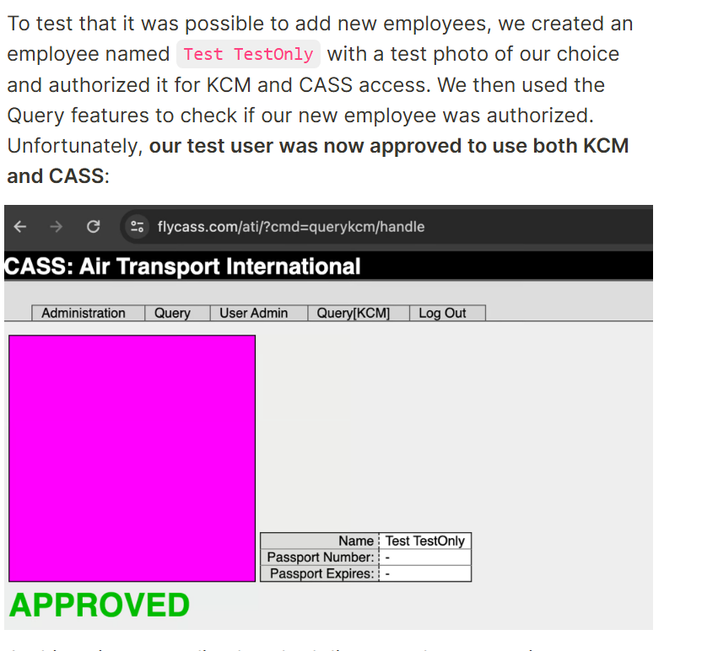
Bypassing airport security via SQL injection (2024!)
"Known Crewmembers" can get to the cockpit without inspection.
Large airlines: Each airline runs its own authorization system, but small airlines rely on a vendor
The authors found one such vendor that had an SQL injection error
Using the username of ' or '1'='1 and password of ') OR MD5('1')=MD5('1, we were able to login to FlyCASS as an administrator of Air Transport International!
OOPs!
https://ian.sh/tsa
Notes:
Followup: After the authors identified the problem, they attempted to report it. On the website they wrote:
We ended up finding several more serious issues but began the disclosure process immediately after finding the first issue.
We had difficulty identifying the right disclosure contact for this issue. We did not want to contact FlyCASS first as it appeared to be operated only by one person and we did not want to alarm them. On April 23rd, we were able to disclose the issue to the Department of Homeland Security, who acknowledged the issue and confirmed that they “are taking this very seriously”. FlyCASS was subsequently disabled in KCM/CASS and later appears to have remediated the issues.
After the issue was fixed, we attempted to coordinate the safe disclosure of this issue. Unfortunately, instead of working with us, the Department of Homeland Security stopped responding to us, and the TSA press office issued dangerously incorrect statements about the vulnerability, denying what we had discovered.

Slide 20
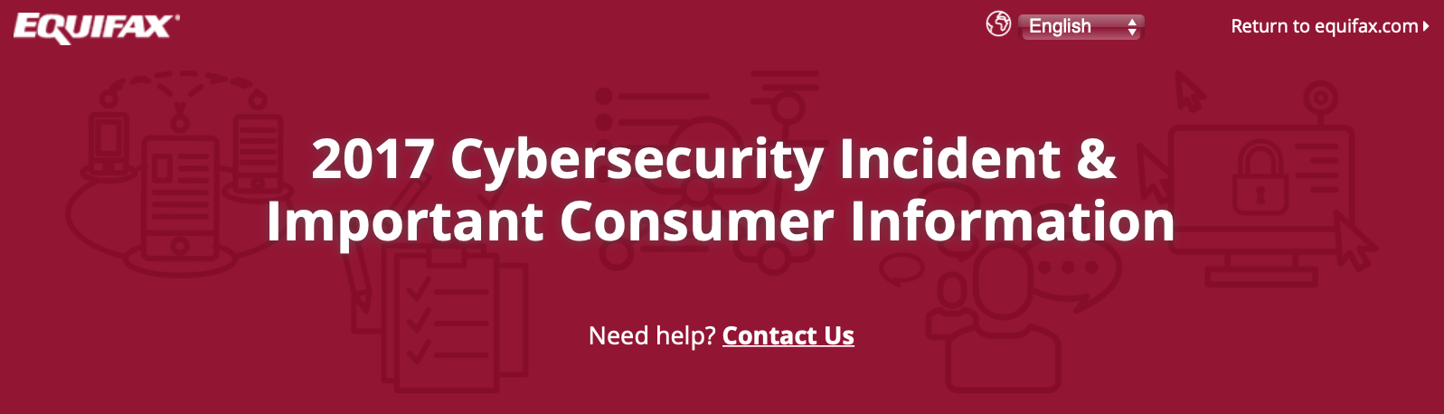
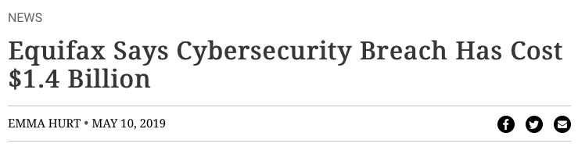
A code injection attack (in Apache struts) cost Equifax $1.4 Billion
CVE-2017-5638 Detail
Current Description
The Jakarta Multipart parser in Apache Struts 2 2.3.x before 2.3.32 and 2.5.x before 2.5.10.1 has incorrect exception handling and error-message generation during file-upload attempts, which allows remote attackers to execute arbitrary commands via a crafted Content-Type, Content-Disposition, or Content-Length HTTP header, as exploited in the wild in March 2017 with a Content-Type header containing a #cmd= string.
Notes:
For example: the Equifax data breach in 2017 that has thus-far cost the firm over 1.4 billion dollars was caused by a vulnerability in their web app, which allowed untrusted user input to flow into a part of the application that would then execute that input as java code.

Slide 21
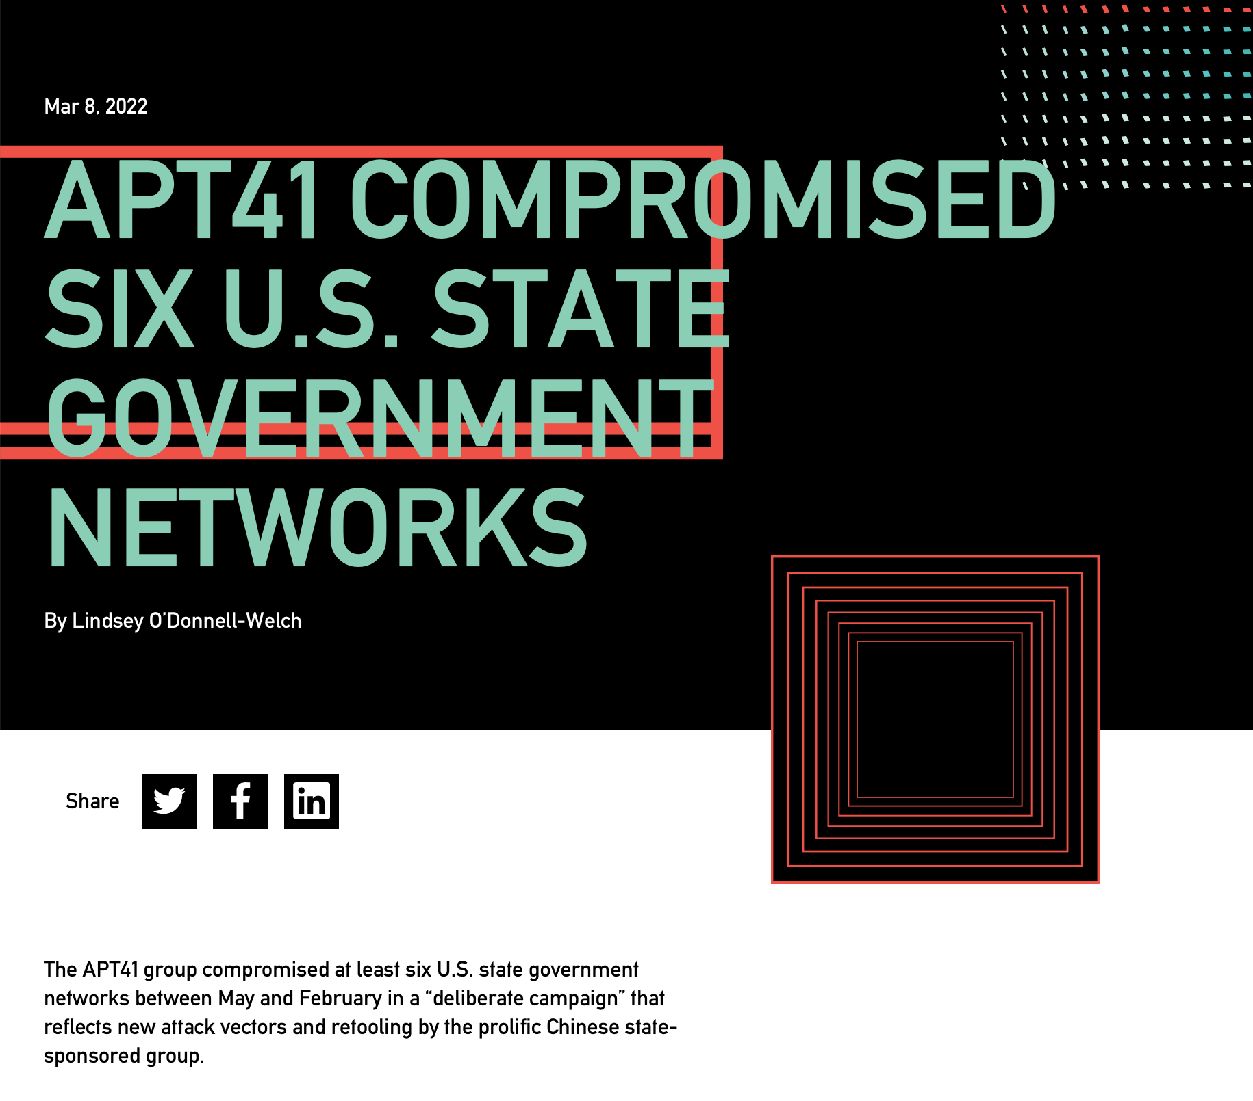
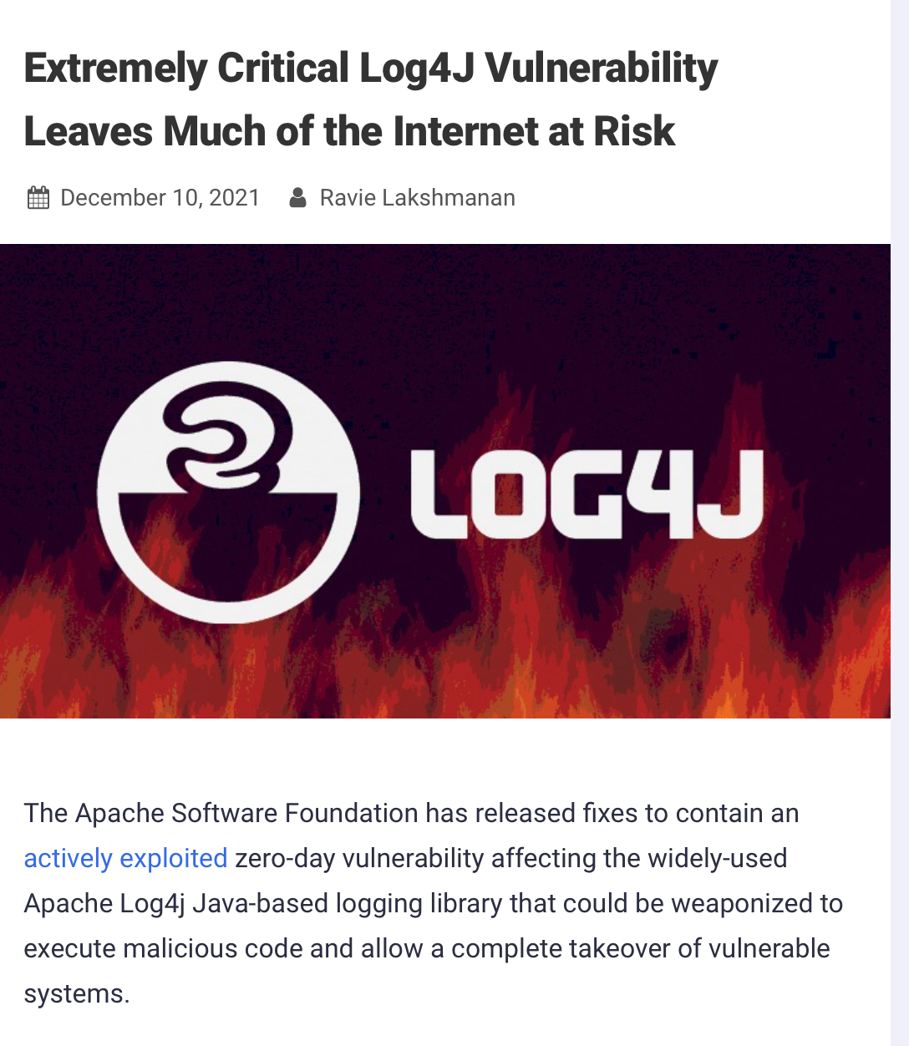
The Log4J code injection vulnerability compromised many networks in 2021
CVE-2021-44228 Detail
Current Description
Apache Log4j2 2.0-beta9 through 2.15.0 (excluding security releases 2.12.2, 2.12.3, and 2.3.1) JNDI features used in configuration, log messages, and parameters do not protect against attacker controlled LDAP and other JNDI related endpoints. An attacker who can control log messages or log message parameters can execute arbitrary code loaded from LDAP servers when message lookup substitution is enabled. From log4j 2.15.0, this behavior has been disabled by default. From version 2.16.0 (along with 2.12.2, 2.12.3, and 2.3.1), this functionality has been completely removed. Note that this vulnerability is specific to log4j-core and does not affect log4net, log4cxx, or other Apache Logging Services projects.
https://nvd.nist.gov/vuln/detail/CVE-2021-44228
https://thehackernews.com/2021/12/extremely-critical-log4j-vulnerability.html
https://duo.com/decipher/apt41-compromised-six-state-government-networks
Notes:
You might think that we have learned a lesson and that we wouldn’t have this kind of vulnerability any more. The Log4J vulnerability in Fall of 2021 was successfully used to compromise many networks, and (click build) was also due to an issue where user-controlled inputs could be executed as code on a trusted component (the directory/LDAP server in this case)

Slide 22
SE-level mitigations for code injection attacks
Use packages like Zod to sanitize inputs
don't do this yourself!
Use eslint rules to check that Zod is used on every input flow
Avoid unsafe query languages (e.g. SQL, LDAP, language-specific languages like OGNL in java). Use “safe” subsets instead.
Avoid use of languages (like C or C++) that allow code to construct arbitrary pointers or write beyond a valid array index
Never use eval() in JS – executes a string as JS code
Notes:
Special characters like <, >, ‘, “ and ` are often involved in exploits involving untrusted inputs. So filter them, and use tools to make sure that every data flow involving user input is filtered.
Query languages might have “safe” apis and “unsafe” APIs, where the “Safe” APIs automatically perform some sanitization, allowing you to add place-holders for arguments to a query that YOU define, where the user-controlled input can ONLY flow into a specific part of the query (preventing the attacker from constructing their own query)
Don’t use “unsafe” languages like C or C++. In these languages you can write beyond a valid array index. Such buffer overflows are the primary way in which an attacker can execute arbitrary code on your app. (There are whole conferences devoted to ways of preventing this.)
And of course don’t use ‘eval’ in JS. Use a lint filter to check for this.

Slide 23
Vulnerability 3: Bad Authentication
This is mostly about password management
Attack surface:
your password system
the attacker may use lists of passwords stolen from other sites
Notes:
"Identification and Authentication Failures" is #7 on the 2021 OWASP Top 10 Web Application Security Risks. (See the page for this module on the course web site for URL).
i

Slide 24
(Inadequate) Mitigation: Don't keep passwords; keep their hashes instead
Cryptographic hash:
Space of hash values is very large (NOT what you'd use for a hash table)
hash collisions should be so rare as to be negligible
can't go from hash code to original
Your table consists of (username, savedHash) where savedHash is the hash of the password they created when they signed up for the site.
Afterwards, the user logs in with (username, maybePassword).
You compare hash(maybePassword) vs savedHash.
Notes:
(Of course, hash codes are smaller than the thing they are hashing, so they can't possibly be 1-1, but it will be impractically hard to go from a hash code h to ANY m s.t. hash(m) = h.)

Slide 25
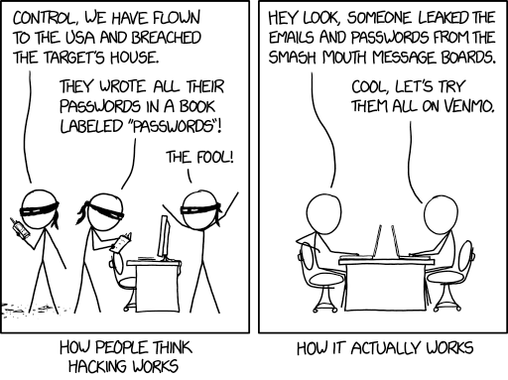
Is this good enough?
…people reuse passwords all the time. Could an attacker take advantage of that?
https://xkcd.com/2176/

Slide 26
Is it safe to store the hashes instead of the passwords themselves?
Imagine that the attacker has stolen your password db, which looks like
(username, hashedpassword)
Next, imagine that the attacker has stolen a table that looks like
(username, password)
this happens all the time!
So they can easily construct a table that looks like
(username, password, hash(password))
This is sometimes called a "rainbow table"
And now they can run a join and retrieve a table that looks like
(username, password)
for each username that is in both tables
OOPs!
Notes:
Give it to someone else — almost always the right move for credit card numbers! But not for

Slide 27
Actual Mitigation: always salt your passwords
For each user, generate a random number called the "salt"
typically 128 bits (16 bytes)
Your password db should now look like
(username, salt, hash(password+salt)
There's no connection between hash(password+salt) and hash(password)
So the rainbow table won't work.

Slide 28
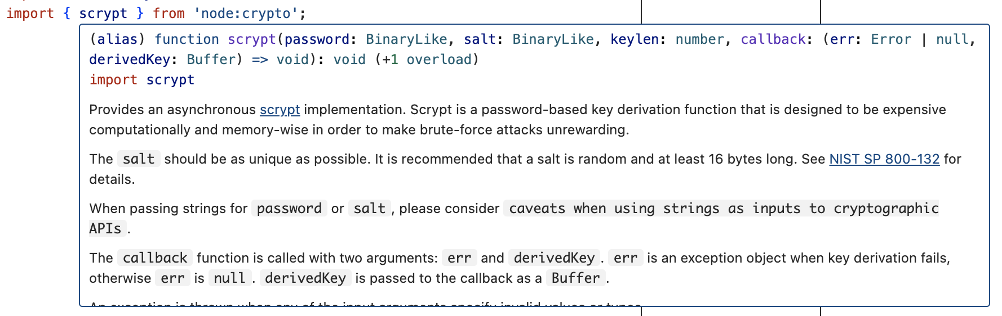
Security Principle: Don't try this at home; use an established solution instead
Use established, well-studied crypto packages
This is a general security principle

Slide 29
Vulnerability 4: Supply-Chain Attacks
Do we trust our own code?
Third-party code provides an attack vector
Notes:
Next, let’s consider so-called software supply chain threats.

Slide 30
The software supply chain has many points of weakness
External dependencies
Build process
Distribution process (including updates)
Operating environment
In-house code
Notes:
The “software supply chain” includes many potential points of weakness. We might need to consider threats at each phase of the software development and deployment process, including:
External dependencies: potential for malicious dependencies
In-house code: potential for insider attack (a developer who is either malicious, or whose laptop has been otherwise compromised through another vulnerability)
Build process: potential for build system to be compromised through another vulnerability or insider attack
Distribution process: potential for a malicious update to be pushed out to your customers
Operating environment: potential for other threats in the operating environment to result in a compromise of our software

Slide 31
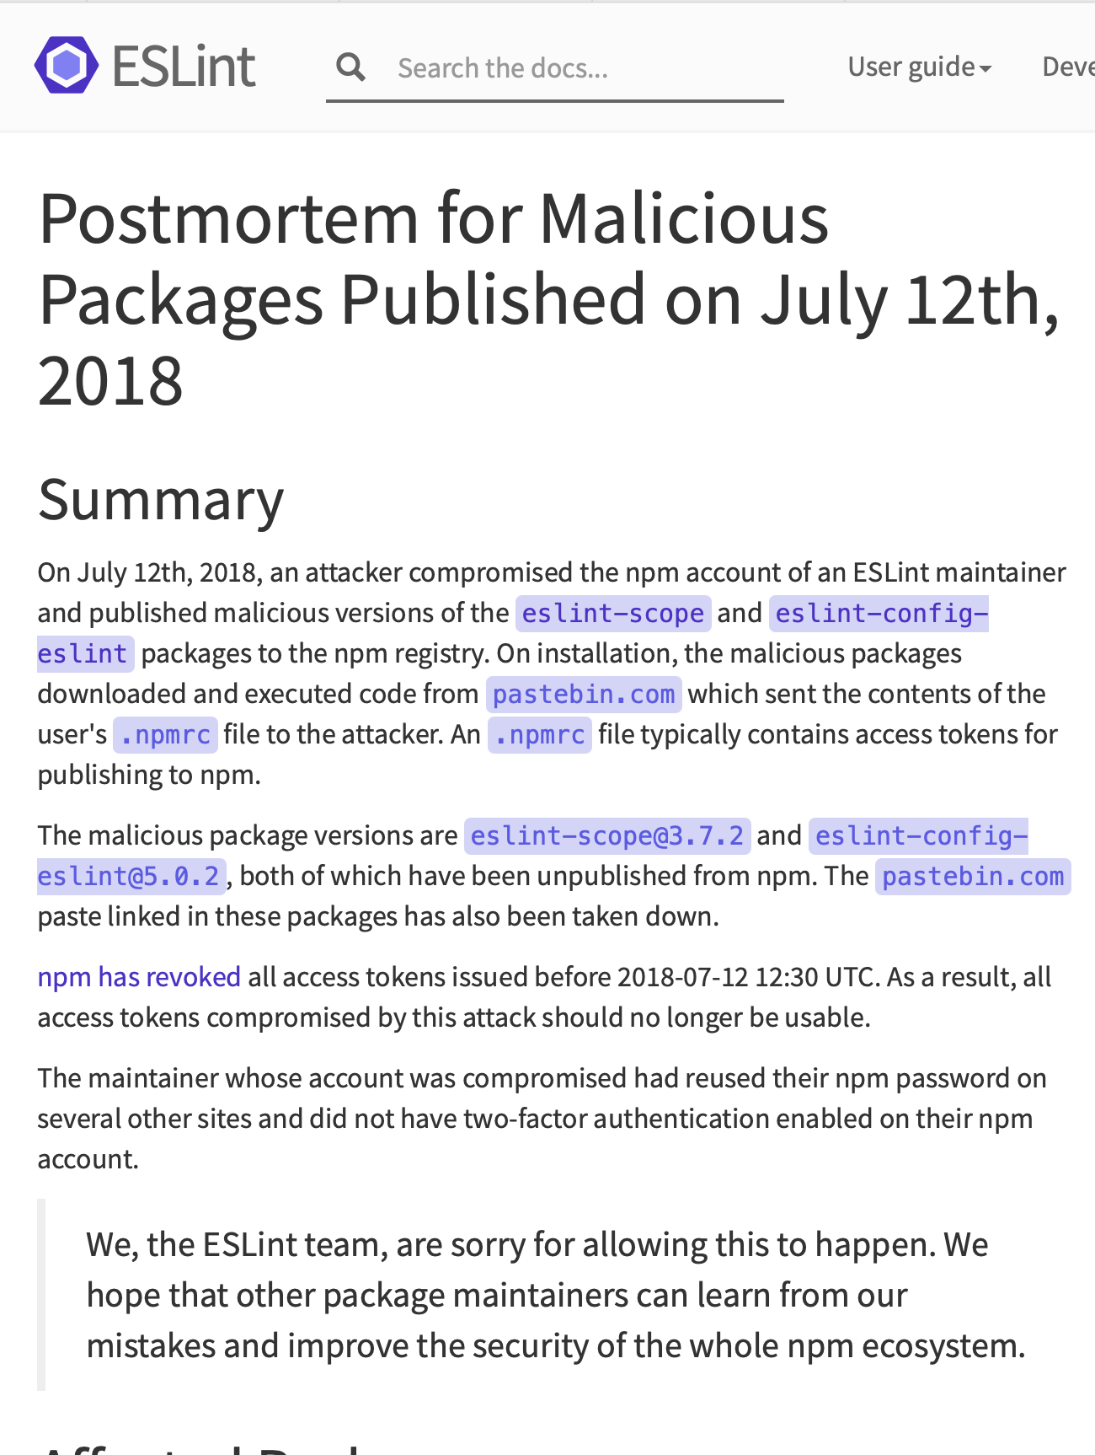
Example: the eslint-scope attack (2018)
On 7/12/2018, a malicious version of eslint-scope was published to npm.
eslint-scope is a core element of eslint, so many many users were affected.
Let’s analyze this…
https://eslint.org/blog/2018/07/postmortem-for-malicious-package-publishes/
Notes:
Let’s look at a couple of examples. In 2018, a malicious version of an eslint package called eslint-scope was published. This was a quite serious issue.
https://eslint.org/blog/2018/07/postmortem-for-malicious-package-publishes/

Slide 32
This incident leveraged several small security failures
An eslint-scope developer used their same password on another site.
The other site did not use 2FA
Password was leaked from the other site.
Attacker created malicious version of eslint-scope
Many users did not use package-lock.json, so their packages automatically installed the new (evil) version.
The malicious version sent copies of the user’s .npmrc to the attacker. This file typically contains user tokens.
Estimated 4500 tokens were leaked and needed to be revoked.
Notes:
Let’s look at the sequence of events, as explained in the post-mortem report on the preceding slide.
<Read Slide>
Discuss: how many violations of good security practices do you see here?
The developer used the same password on two different sites
The other site did not use 2FA
The other site did something else that allowed the password to leak.
Users did not protect their packages against silent version updates.

Slide 33
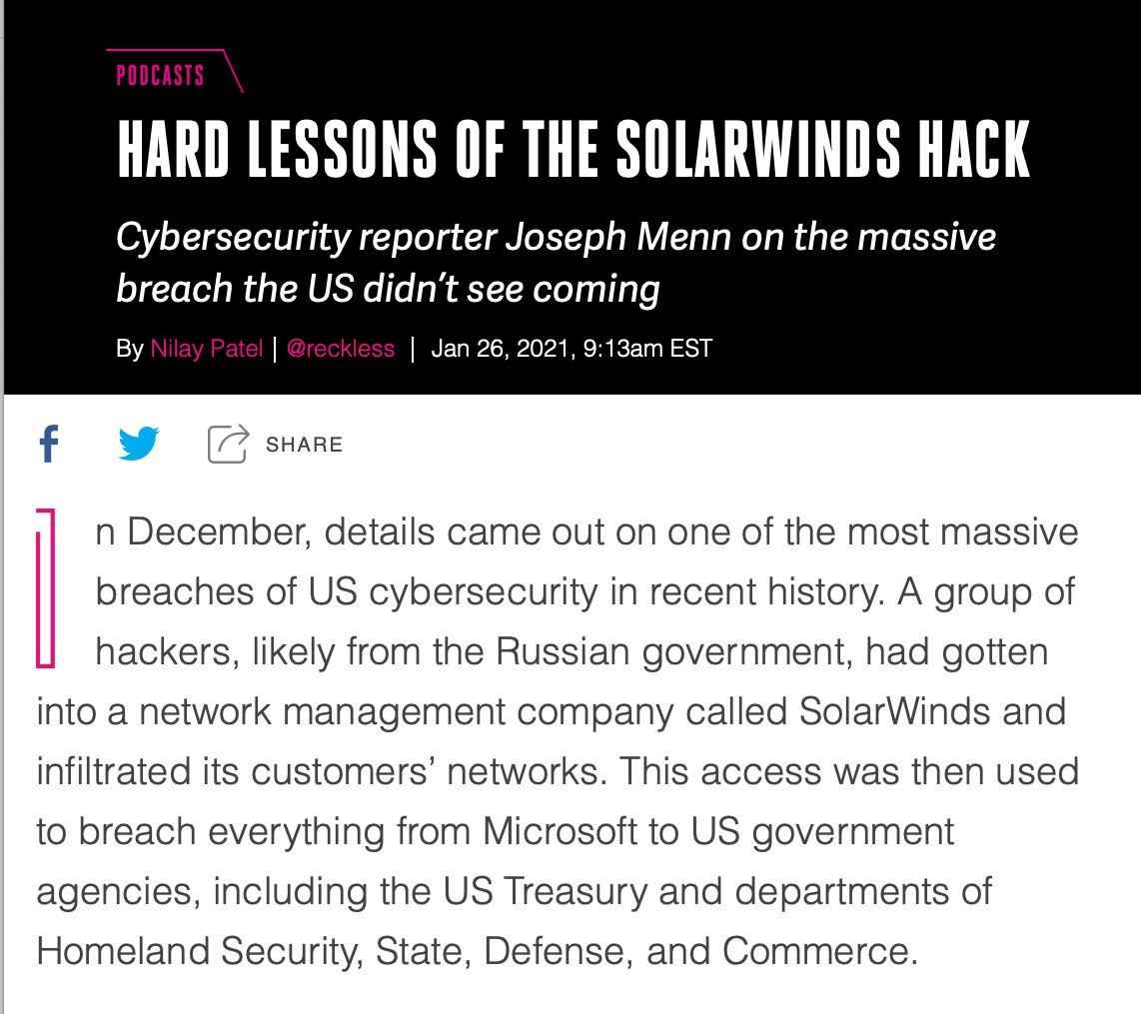
Example: the SolarWinds attack (2020)
Many networks compromised
Not discovered for months

Slide 34
This problem was recognized ages ago
Ken Thompson (the Unix guy) - 1984
Showed how to plant a bug in a compiler, so that any program compiled by that compiler would contain a backdoor.
The final step is represented in Figure 3.3. This simply adds a second Trojan horse to the one that already exists. The second pattern is aimed at the C compiler. The replacement code is a Stage I self-reproducing program that inserts both Trojan horses into the compiler. This requires a learning phase as in the Stage II example. First we compile the modified source with the normal C compiler to produce a bugged binary. We install this binary as the official C. We can now remove the bugs from the source of the compiler and the new binary will reinsert the bugs whenever it is compiled. Of course, the login command will remain bugged with no trace in source anywhere
Notes:
Ken Thompson, in his Turing lecture from 1984, wrote a 3-page paper showing how to plant a back door in the C compiler that would be undetectable by any inspection of the compiler's source code (!)

Slide 35
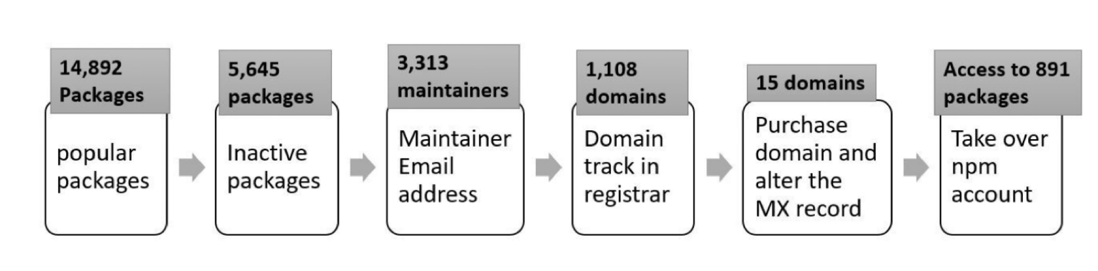
A 2021 NCSU/Microsoft found that many of the top 1% of npm packages had vulnerabilities
Package inactive or deprecated, yet still in use
No active maintainers
At least one maintainer with an inactive (purchasable) email domain
Too many maintainers or contributors to make effective maintenance or code control
Maintainers are maintaining too many packages
Many statistics/combinations: see the paper for details.
“What are Weak Links in the npm Supply Chain?” By: Nusrat Zahan, Thomas Zimmermann, Patrice Godefroid, Brendan Murphy, Chandra Maddila, Laurie Williams https://arxiv.org/abs/2112.10165
Notes:
Here is a list of significant vulnerabilities found in the most popular packages (“top 1%”).

Slide 36
Your suppliers' risks are your risks
"Known Crewmembers" can get to the cockpit without inspection.
Large airlines: Each airline runs its own authorization system, but small airlines rely on a vendor
The authors found one such vendor that had an SQL injection error
Using the username of ' or '1'='1 and password of ') OR MD5('1')=MD5('1, we were able to login to FlyCASS as an administrator of Air Transport International!
OOPs!
https://ian.sh/tsa
Notes:
The problem with supply-chain vulnerabilities is that they are recursive! Your suppliers' risks easily become your risks.

Slide 37
Your suppliers' risks are your risks.
MOVEit is a file transfer program owned by Progress Software.
Over 2500 organizations used the program to move sensitive personal data.
They were attacked in May 2023.
Prof. Wand says: my bank didn't use MOVEit, but they used a supplier who did.
Now, they have to take expensive steps to offer me identity-protection services, etc.
Notes:
Prof. Wand says: I received two letters like this from two of my financial institutions within a week.

Slide 38

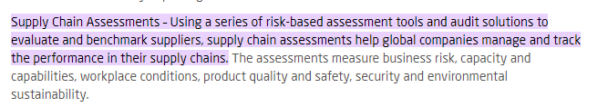
Supply-chain risks include more than just software.
Notes:
Of course, supply-chain security risks include more than just software. Your suppliers are subject to regulatory risks, transportation risks, etc, etc. Will your supplier in West Arstotzka (*) be taken over by the government, or overrun by mercenaries or rioters?
So of course there are consultants to help you manage all that. Here’s the web page of one such firm. (found after 30 seconds of googling)
[* Arstzoska is the name of a fictional country I found on Wikipedia]

Slide 39
Process-level Threat Mitigations
External dependencies
Audit all dependencies and their updates before applying them
In-house code
Require developers to sign code before committing, require 2FA for signing keys, rotate signing keys regularly
Build process
Audit build software, use trusted compilers and build chains
Distribution process
Sign all packages, protect signing keys
Operating environment
Isolate applications in containers or VMs
Notes:
While we could easily solve problems in our own code by bolting on some useful additional components (like using SSL), it’s not so easy to solve threats to our software supply chain process – there need to be process-based solutions for these process-based problems.
These kinds of threats are currently some of the most-talked about (and most feared) because they are complex to defend against.
For example: how do we audit dependencies? Who does that, and when? What is “secure enough” for a dependency?
Who loves needing to do 2FA for every time you sign into canvas? How much worse is it if you had to do it for each git commit?
Signatures are useful only insofar as we trust the signer. If a developer’s computer is compromised (say, through a phishing attack), what good is that signature? Same for distribution.
Perhaps the best news-you-can-use here is to isolate each application in its own container or VM, reducing the scope of security breaches to be isolated within that environment and not directly impacting other applications.

Slide 40
Vulnerability #5: Failure to Apply Security Policies
Remember the outline of our lecture:
Definition of key vocabulary
Some common vulnerabilities, and possible mitigations
Getting security right is about people as well as software.
Notes:
This brings us to the third item in our outline (from way back on slide 3)

Slide 41
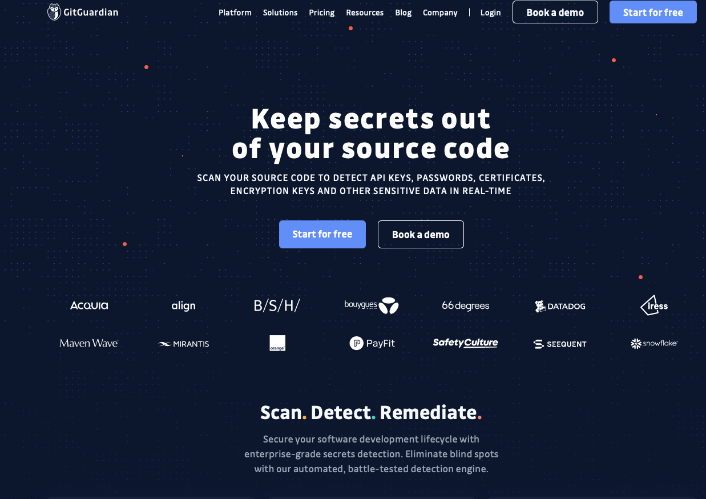
Example mechanism: secret detection
Recall: SSL only talks about public/private keys.
Applications may have many other secret values (e.g. access tokens for other services)
Tools like GitGuardian automatically detect secrets in repositories
What happens when we put that in the toolchain?

Slide 42
Do developers keep secret keys secret, even when they are warned?
Industrial study of secret detection tool in a large software services company with over 1,000 developers, operating for over 10 years
What do developers do when they get warnings of secrets in repository?
49% remove the secrets; 51% bypass the warning
Why do developers bypass warnings?
44% report false positives, 6% are already exposed secrets, remaining are “development-related” reasons, e.g. “not a production credential” or “no significant security value”
Is it a tool problem or a management problem?
“Why secret detection tools are not enough: It’s not just about false positives - An industrial case study”
Md Rayhanur Rahman, Nasif Imtiaz, Margaret-Anne Storey & Laurie Williams https://link.springer.com/article/10.1007/s10664-021-10109-y
Notes:
Simply using a secret detection tool isn’t enough. This is an interesting study.
(Read slide for key findings)
Discussion:
Bypassing warnings for false positives (e.g. not an actual credential) are reasonable (although perhaps annoying); the remaining reasons that are “development related” such as: * It is not a production credential (for example, it is a credential for a non-shipping prototype)
The credential doesn’t protect any data, service, etc., with significant security value
Rely on judgement calls of the developer that do not reflect overall security model. Many successful attacks rely on chaining multiple vulnerabilities together, getting a foothold in one system to then be able to access another. These kinds of judgement calls should not be made at the level of individual developers who may not see the whole security landscape.
Other reasons why secrets not promptly removed:
* Removing the credential now would break services. etc., that belong to other teams
* We were not sure what secret management/other solution we can use to resolve the problem.
These are process-related issues, and require

Slide 43
Other mitigations for access-control threats
Implement multi-factor authentication
Make sure passwords are not weak, have not been compromised.
Apply per-record access control
Principle of least privilege
Harden account creation, password reset pathways
Use an expert vendor, like Auth0, to handle login
They can do it better than you can.
But how do you get your developers to do all this?
Notes:
That article described the situation faced by end users, but the situation for developers is even worse: developers have to keep their personal devices secure, but they also have to produce systems that defend against the attacks we’ve discussed.
<click>
But all the mitigations in the world won’t help you if you can’t get the people in your organization to use them.
Whatever the security policy is, you have to get your developers to apply it.

Slide 44
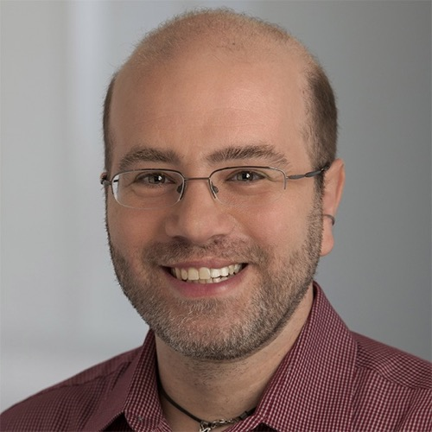
David Blank-Edelman (former head of Systems at Khoury)
“The solution is in front of the screen, not behind it”
Notes:
As David Blank-Edelman(*) used to say: “the solution is in front of the screen, not behind it.”
(*) former head of Systems at Khoury

Slide 45
A security architecture must include a security culture
Security architecture is a set of mechanisms and policies that we build into our system to mitigate risks from threats
Vulnerability: a characteristic or flaw in system design or implementation, or in the security procedures, that, if exploited, could result in a security compromise
Threat: potential event that could compromise a security requirement
Attack: realization of a threat
Notes:
It’s not just software, it’s not just company policy– we need to make sure our development teams have a culture that includes security.

Slide 46
Incorporating Security into an Agile Development Process
Collaborate with stakeholders to understand security needs
Frequent and small iterations
Start with the thinnest slice of the system. e.g.,
User registration flow
A microservice and it’s collaborating services
Current iteration
Repeat and refine them.
Notes:
Now let's start on our final topic… <Read Slide>

Slide 47
Let’s Walk through an Example
Imagine working on this user story
“As a customer, I need a page where I can see my customer details so I can confirm they are correct”
Let’s work through our questions:
What are you building?
What can go wrong?
What are you going to do?
Notes:
<read slide>

Slide 48
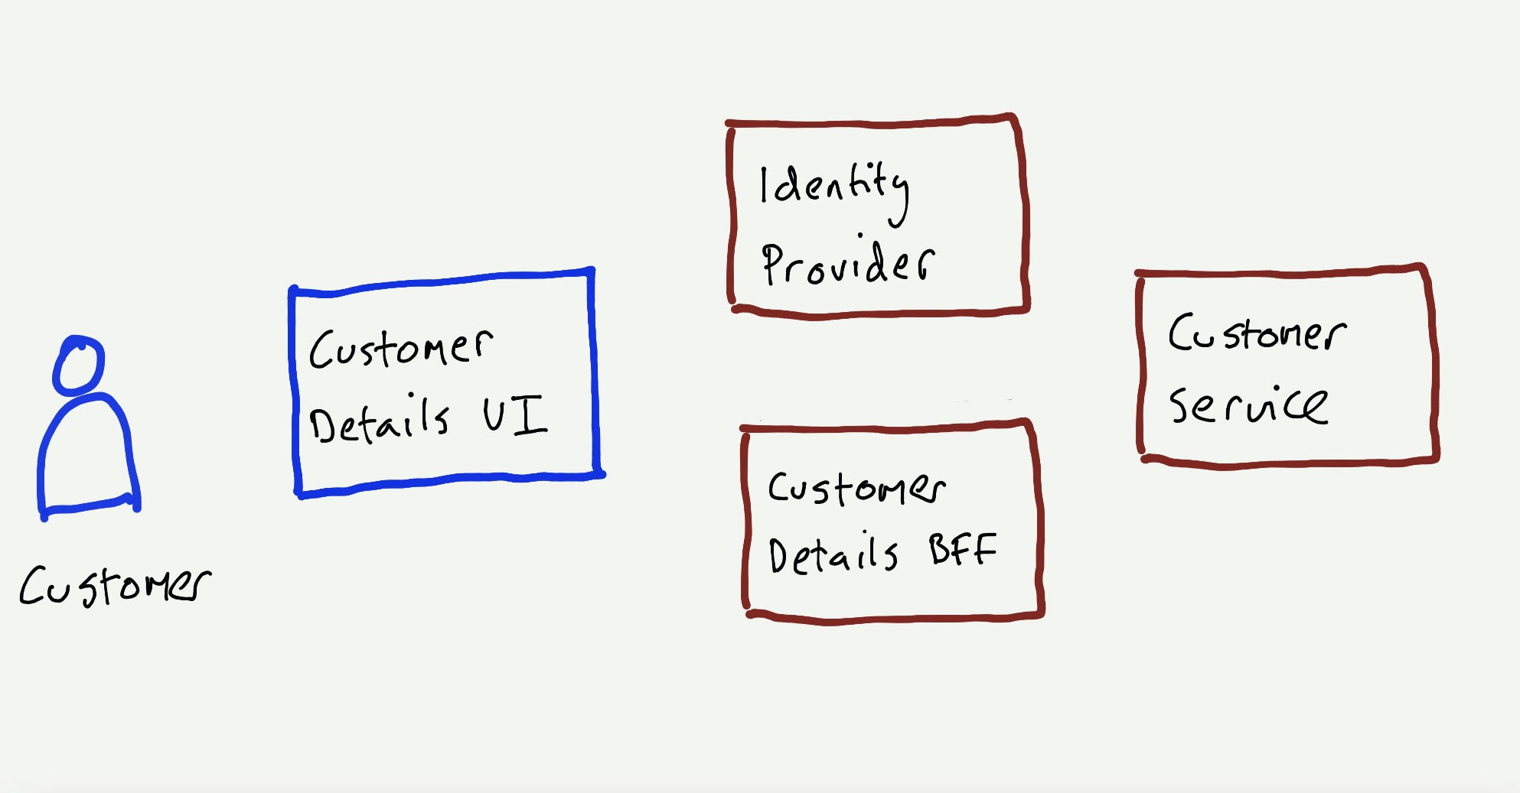
What are we building?
Use a sketch to represent
relevant components
users who interact with a component
collaborative components
Notes:
<read slide>

Slide 49
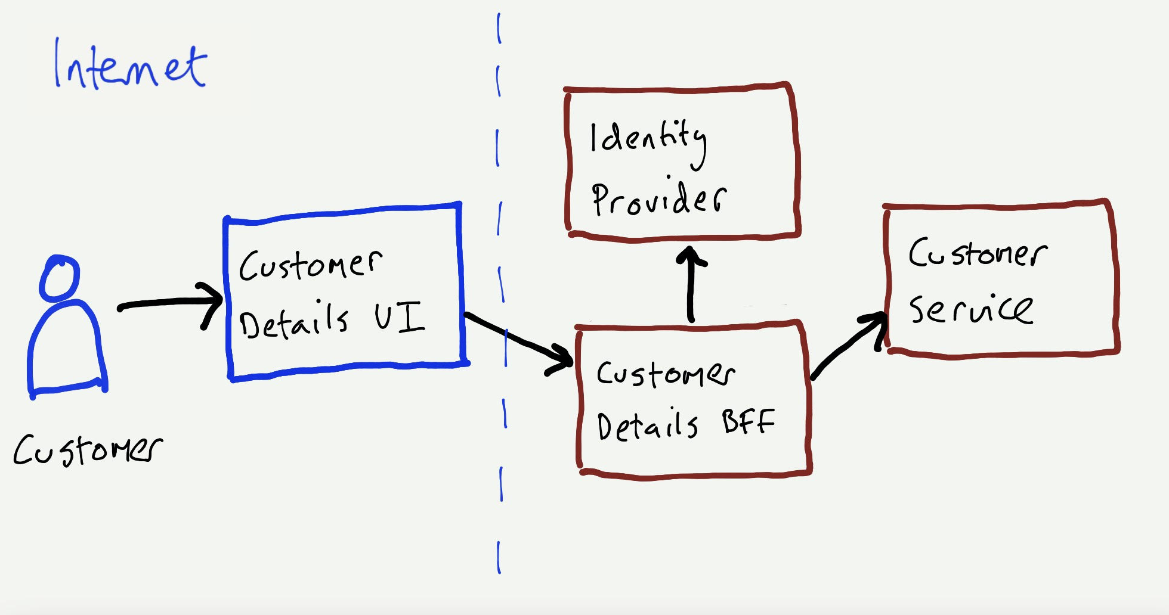
What are we building?
Explicitly model data flows in the sketch.
Data flows help show where requests originate (source).
Label networks and show boundaries between them.
Notes:
<read slide>

Slide 50
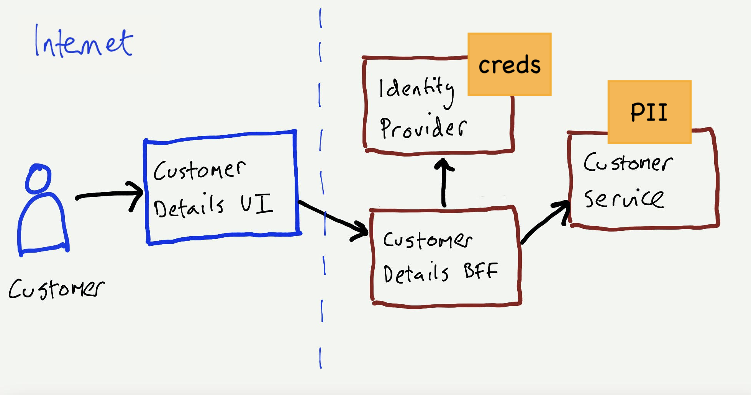
What are we building?
Identify and show assets e.g., personally identifiable information (PII), your application has access to.
Notes:
<read slide>

Slide 51
Every data flow is an attack surface
There may be vulnerabilities on each flow.
Customer -> UI
Customer -> Identity Service
UI -> BFF
BFF -> Customer Service
Notes:
<read slide>

Slide 52
Identify the vulnerabilities and threats on each flow
Identify the possible vulnerabilities and threats on each flow.
Customer -> UI
Customer -> Identity Service
UI -> BFF
BFF -> Customer Service
No 2-factor authentication
XSS attack
Absent/weak authentication (server-to-server)
No logging of caller identity
Privilege escalation by authenticated user
Absent/weak identity token validation
injection attacks
Misconfigured TLS configuration
Privilege of escalation by authenticated user
Flood of traffic from bots
Notes:
<read slide>
Moral: every data flow is an attack surface!
(Discuss: are the notations on the flows vulnerabilities, threats, or something else? My answer: the slide doesn't really make a distinction}

Slide 53
Choose highest priority vulnerabilities
Add Highest Priority threats to backlog (as user stories or conditions of satisfaction)
Given the user is logged in When they request to view their profile page And they have a valid token
Then their profile page is displayed
Given the user is logged in
When they request to view their profile page
But they do not have a valid token
Then they are asked to login or signup
Notes:
<read slide>

Slide 54
What are you going to do?
Prioritize and Fix
Aim to address manageable number of threats (e.g., 3)
Examples:
Authorization bypass when accessing an API.
XSS attack via user input.
Denial of service from the internet
Repeat and refine!
A Guide to Threat Modeling by Jim Gumbley: https://martinfowler.com/articles/agile-threat-modelling.html
Notes:
<read slide>

Slide 55
Elements of a security culture
Make security a regular part of the process.
Include security tools as part of the build/release process
Tools may have false positives and false negatives
Educate developers about when how to recognize positives that look false, but aren’t
Include security review as regular part of code review
Notes:
<read slide>
Your developers will be more conscious of security issues if they discuss them on a regular basis during their ordinary workflow.

Slide 56
Learning Objectives for this Module
You should now be able to:
Define key terms relating to software/system security
Explain 5 common vulnerabilities in web applications and similar software systems, and describe some common mitigations for each of them.
Explain why software alone isn’t enough to assure security
Explain at least one way in which security can be incorporated into an agile development process

